Slide 1
US TRAINING
BinaxNOW™ COVID-19 Ag Card & NAVICA™ App
Notes:
Hello everyone and thank you for joining us today to talk about the BinaxNOW COVID-19 Antigen Test Card & NAVICA App. My name is , and I am a Technical Consultant with Abbott Rapid Diagnostics. As we go through the training today, please feel free to enter questions into the chat box. We’ll also have time at the end of this session to address any additional questions that you may have.

Slide 2
BinaxNOW™ COVID-19 Ag Card & NAVICA™ App
Training Agenda
1
BinaxNOW™ COVID-19 Ag Card Overview
2
NAVICA™ App Overview
3
Training Toolkit Review
Notes:
Today we’ll go over the details of the BinaxNOW COVID-19 test card and use, an overview of the NAVICA App, and I’ll also show you where to find some helpful tools and documents online.

Slide 3
BinaxNOW™
COVID-19 Ag Card
Overview
Emergency Use Authorization Granted by FDA
Notes:
This test was granted emergency use authorization, also known as EUA by the FDA.

Slide 4
Intended Use: Key Points
The BinaxNOW™ COVID-19 Ag Card is intended for the qualitative detection of nucleocapsid protein antigen from SARS-CoV-2 in nasal swabs from individuals suspected of COVID-19 by their healthcare provider within the first seven days of symptom onset.
Antigen is generally detectable in nasal swabs during the acute phase of infection.
Negative results should be treated as presumptive and confirmation with a molecular assay, if necessary, for patient management, may be performed.
Proprietary and confidential — do not distribute
Notes:
The full intended use statement is provided in our product insert and each test kit.
The BinaxNOW COVID-19 antigen card is intended for use for the qualitative detection of the SARS-coV-2 antigen from individuals suspected of COVID-19 by their healthcare provider within the first seven days of symptom onset. The antigen is generally going to be detectable in nasal swabs during the acute or active phase of infection. Negative results from patients with symptoms beyond those seven days should be treated as presumptive and confirmation with the molecular assay if necessary, for patient management may be considered and performed.

Slide 5
BinaxNOW™ COVID-19 Ag Card
Emergency Use Authorization
The BinaxNOW™ COVID-19 Ag Card is only for use under the Food and Drug Administration’s Emergency Use Authorization
What is Emergency Use Authorization (EUA)?
FDA emergency access mechanism
Health & Human Services declare when circumstances exist to justify use of diagnostics under EUA for the diagnosis of COVID-19
It is not full FDA clearance or approval and is temporary, until the declaration is terminated or revoked.
Proprietary and confidential — do not distribute
Notes:
You might have heard about Emergency Use Authorization or heard of diagnostic testing being granted EUA, but here is a quick refresher:
The FDA created an emergency access mechanism, which is Emergency Use Authorization. EUA is a mechanism enabling Abbott to bring diagnostic testing to market quickly for immediate utilization. It's important to note that EUA is not a full FDA clearance or approval. EUA is considered temporary until the declaration is terminated and then revoked.

Slide 6
BinaxNOW™ COVID-19 Ag Card
Emergency Use Authorization
Test Site Obligations:
Notify relevant public health authorities on intent to run test
Report all results to healthcare providers and include the Healthcare Provider Fact Sheet. Healthcare providers to include Patient Fact Sheet with results
Utilize product as outlined in the BinaxNOW COVID-19 Ag Card Instructions for Use
Ensure all operators are trained to perform and interpret the test
Have process in place for reporting test result to Healthcare Providers & relevant public health authorities
Per Product Insert: Collect performance data and report any significant deviations from the product performance characteristics via email to FDA/HHS and to Abbott Technical Support
Retain all records associated with EUA until otherwise directed by FDA
Proprietary and confidential — do not distribute
Notes:
Each testing site has certain obligations when utilizing a diagnostic testing under Emergency Use Authorization.
- Organizations must notify all relevant public health authorities on their intent to run test.
Test results should be reported to health care providers and include the Healthcare Provider Fact Sheet.
Test providers should hand out a patient fact sheet to each patient/participant with each result.
The Healthcare Provider and Patient Fact sheets are included with each test kit.
Utilize product as outline in the BinaxNOW COVID-19 Ag Card instructions.
Ensure all operators are trained to perform testing and interpret results .
Each testing site needs to have a process in place for reporting testing results to Healthcare providers and relevant public health authorities.
Per the product insert, performance data should be collected, and any significant deviations reported via email to Abbott Technical Services.
Sites must retain all records associated with EUA until otherwise directed by FDA.
There are some very important responsibilities that come with testing or doing any type of COVID-19 testing under emergency use authorization. Please note that these are not just specific to laboratories or hospitals that are doing testing, but any facility that plans to begin COVID-19 testing.

Slide 7
COVID-19 CARES Act Reporting Requirements
Reporting requirements apply to COVID-19 testing sites performing testing, including:
Laboratories that perform clinical testing under a Clinical Laboratory Improvement Amendments (CLIA) certificate
Non-laboratory COVID-19 testing locations
Other facilities or locations offering COVID-19 point-of-care tests, or in-home tests
Reach out to state agencies for specific guidance on implementation for reporting
Proprietary and confidential — do not distribute
Notes:
For reporting of results to state agencies, testing sites should be familiar with the CARES Act. The CARES Act states that ALL testing sites must report results, both positive AND negative test results. Be sure to reach out to your individual state agencies for specific guidance on implementation and reporting.

Slide 8
Government Resources for COVID-19 Testing
PREP Act Coverage for COVID-19 Testing
Guidance from the Department of Health and Human Services
FDA’s FAQ on Testing for SARS-CoV-2
FDA Recommendations for Health Care Providers
Proprietary and confidential — do not distribute
Notes:
There are additional resources you can refer to for questions on intended.
As a manufacturer, Abbott is unable to speak to or promote the utilization of this test outside of what's specifically stated in our product insert and our specific intended use statement. We understand there may be questions surrounding utilizing this test and how this is going to impact testing at each facility. The FDA and Health and Human Services have provided guidance for utilizing COVID-19 testing outside of what a manufacturer's intended use or authorization may be. For questions outside of the Intended Use, facilities should contact Health and Human Services or see the FDA's frequently asked questions on testing for SARS-COV-2.

Slide 9
BinaxNOW™ COVID-19 Ag Card Technical Overview
Notes:
Now we're going to get into the technical overview of the BinaxNOW COVID-19 antigen card itself.

Slide 10
BinaxNOW™ COVID-19 Ag Card
Product Overview
Test Summary | Rapid lateral flow immunoassay for the qualitative detection of SARS-CoV-2
Testing Environment | Point of Care settings with a CLIA Certificate of Waiver, Compliance or Accreditation
Specimen Type | Direct nasal swab
Time to Result | Results visually read at 15 minutes *Results should not be read after 30 minutes
Waste Disposal | All components should be discarded as Biohazard Waste
PPE for Specimen Collection & Handling | Refer to CDC Guidelines for collecting, handling and testing clinical specimens (link in Product Insert)
Proprietary and confidential — do not distribute
Notes:
This grid provides a great product overview highlighting several important aspects of the BinaxNOW COVID-19 Ag Card test.
First, it is a Rapid lateral flow immunoassay for the qualitative detection and diagnosis of the antigen from the SARS-CoV-2 virus
The test should be utilized at or near the Point of Care in settings operating under CLIA Certificate of Waiver, which is a requirement.
The specimen type is a Direct nasal swab, and only the swabs that are provided in the test kits are to be used for this test.
Results are visually read at 15 minutes. Results cannot be read or interpreted after 30 minutes.
Each test kit contains 40 test cards, extraction reagent, QC material, patient collection swabs, product insert, procedure card and fact sheet. These kits should be stored at room temp or 2-30°C. Each kit also contains one larger healthcare provider fact sheet, and then a smaller pad of patient fact sheets that can be torn off and given to each patient that's being tested.
ALL components of this test kit should be discarded as Biohazard Waste. So yes, we do mean that the biohazard waste should be initiated and set up. This is a red bag biohazard waste requirement.
In regards to PPE for specimen collection and handling, we do not have any specific or additional requirements for PPE outside of what the CDC guidelines already recommend. We do encourage you to refer to the CDC guidelines for collecting, handling and testing clinical specimens and we do provide the link to this website directly in our product insert.

Slide 11
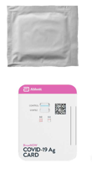
Reagent and Materials
Materials Provided:
40 Test Cards
Extraction Reagent
Patient Collection Nasal Swabs
Positive Control Swab
Blank Nasal Swab for Negative Control
Product Insert
Procedure Card
Healthcare Provider & Patient COVID-19 Fact Sheets
Materials Required but not Provided:
Clock, timer or stopwatch
Optional Materials:
Plastic Transport Tube
Storage & Stability:
Store kit at 2-30°C
Ensure all test components are at room temperature before use
Stable until the expiration date marked on the outer packaging
Proprietary and confidential — do not distribute
Notes:
The materials that are needed to perform the test are all included in each kit, with the exception of a stopwatch and optional transport tube. Each kit includes 40 test cards, a bottle of extraction reagent, patient collection swabs, a silver-wrapped positive control swab, a blank swab to be used as a negative control, the product insert and procedure card, and the healthcare provide and patient fact sheets. You’ll need to also have a clock or timer available. The kits should be stored at room temperature, and you should always ensure that the testing components are at room temperature before use. You’ll notice that on the back of the packaging, the expiration date and lot number are listed.

Slide 12
Quality Control
Internal Procedural Controls:
BinaxNOW™ COVID-19 Ag Card has built-in procedural controls
In an untested card there will be a blue line at the Control Line position
In a valid, tested device, the blue line washes away and a pink/purple line appears, confirming that the sample has flowed through the test strip and the reagents are working
Note: If the blue line is not present at the Control Line position prior to running the test, do not use and discard
Proprietary and confidential — do not distribute
Notes:
The BinaxNOW COVID-19 antigen card has built in internal procedural controls. In an untested card, there will be a blue line present at that control line position. The top line position is where your blue control line will be. Once a test has been performed, the blue line will wash away and a pink or purple line will appear confirming that the sample has flowed through the test strip and that the reagents are working appropriately.
So again, this internal procedural control is something that happens automatically. It's going to confirm that the test card that and reagents are working appropriately. Abbott recommends recording all results with each test run.
Please note that if the blue line is not present at the control line position prior to running and beginning a test, the test card should be discarded and reported to Abbott Technical Services.

Slide 13
When is Quality Control Required?
External Positive & Negative Controls:
Good laboratory practice suggests the use of positive and negative controls to ensure that test reagents are working properly and that the test is correctly performed
BinaxNOW™ COVID-19 Ag Card kits contain a positive control swab and sterile swabs that can be used as a negative control
Required Frequency:
New shipments received
Untrained operators
Conforming with local, state, and/or federal regulations, accrediting groups, or lab’s standard QC procedures.
Note: If correct results are not obtained, contact the Abbott Technical Services Team at
1-800-257-9525 between 8 a.m. and 8 p.m. EST Monday-Friday before testing patient specimens
Proprietary and confidential — do not distribute
Notes:
In addition to internal procedural controls, Abbott recommends the use of a positive and negative control to ensure test reagents are working appropriately and tasks are performed correctly. Each BinaxNOW COVID-19 antigen card kit will contain a positive control swab. As pictured here, it will come in a foil pack just as you see. We do encourage the use of a blank patient swab to be used as the negative control.
Nothing in the test kit will specifically be labeled negative quality control swab, but it is required to perform both a positive and a negative control. A blank patient swab should be used for the negative control test. The manufacturer requirements for frequency of external quality control is with each new shipment received and for any untrained operators. As always, facilities should comply with local, state and federal regulations regarding any additional QC they may require.
New operators should perform one positive AND one negative, so they demonstrate the capability to interpret both a positive and a negative result on the test card. If correct QC results are not obtained, the facility should contact the Abbott Technical Services team.

Slide 14
Nasal Swab Sample Collection
Only the swab provided in the kit is to be used for nasal swab collection
Insert the nasal swab into the nostril exhibiting the most drainage or congestion
Using gentle rotation, push the swab until resistance is met
At the level of the nasal turbinates
Less than one inch into nostril
Firmly sample the nasal wall by rotating the swab in a circular path against the nasal wall 5 times or more for a total of 15 seconds
Slowly remove the swab
Using the same swab, repeat sample collection in the other nostril
Notes:
Now we’re going to cover sample collection, specimen transport, and storage. As we previously mentioned, the approved sample type for the BinaxNOW COVID-19 antigen card is a direct nasal swab. It is very important that only the swabs provided in the test kit are to be used for a nasal swab collection. No other swabs are to be used.
- The swab is inserted into the first nostril until resistance is met, which is at the level of the nasal turbinate or about one inch.
- The swab is rotated against the nasal wall five times or more for a total of 15 seconds to get a good specimen collection and representation of the nasal passage.
- This process is repeated in the second nostril using the same swab.
The anatomical guide for sampling is provided in each test kit and is also available in electronic format on the training toolkit. For optimal performance, Abbott recommends testing specimens immediately after collection. This is a test that's meant to be run at the point of care or near patient care testing.

Slide 15
Specimen Transport & Storage
For best performance, direct nasal swabs should be tested as soon as possible after collection.
If immediate testing is not possible:
Do not return the nasal swab to the original paper packaging
To avoid contamination and preserve sample integrity, place the nasal swab in a clean, unused, tightly capped plastic tube & label with the patient information
The sample is stable in the plastic tube at room temperature (15-30°C) for up to one (1) hour prior to testing
If greater than one (1) hour delay occurs, dispose of sample & collect new sample
Notes:
However, we understand immediate testing may not always be an option. If immediate testing is not possible, there are some key points to remember if a site plans on transporting or storing these specimens at all.
First and foremost, do not return the swab to its original packaging.
The nasal swab can be placed in a clean, unused, tightly capped plastic tube, and then labeled with the appropriate patient information.
The nasal swab in the plastic tube will be stable at room temperature for up to one hour prior to testing.
If more than a one-hour delay occurs, the sample should be disposed and a new sample collected for testing.
If there are questions related to the specimen transport tubes or inquiries about how to purchase transport tubes, facilities can contact Abbott Customer Service.

Slide 16
Specimen Transport & Storage
Notes:
This diagram shows the necessary materials required to transport a patient specimen.
A clean unused plastic tube, caps to close the tube and a patient label.
First cap the plastic tube.
The appropriate patient information written on the label and affixed to the plastic tube.
Collect the nasal swab specimen from the patient and place the nasal swab in the clean unused plastic tube.
Finally, place the cap on the tube and transport it to the testing area.
Remember that the specimen is stable for one hour at room temperature.

Slide 17
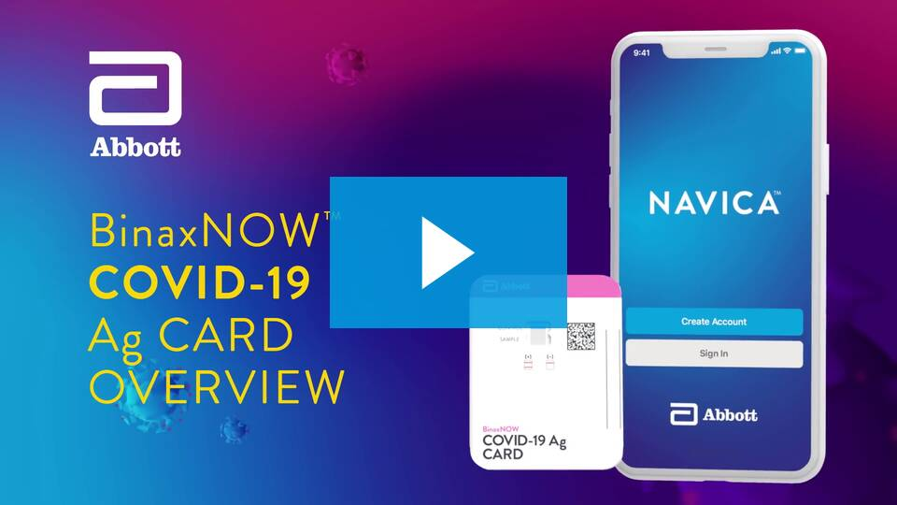
BinaxNOW™ COVID-19 Ag Card Demonstration Video
BinaxNOW Covid19 Antigen Test Demonstration Video - (R10) EN/US - Abbott

Slide 18
BinaxNOW™ COVID-19 Ag Card Test Procedure Overview
Proprietary and confidential — do not distribute
Notes:
This diagram highlights key points from the test procedure steps, and it is taken from the procedure card that is included in each test kit.
It is 4 simple steps, with the 5th step visually reading results.
Step 1 add the extraction reagent.
Step 2 insert the nasal swab into the test card.
Step 3 rotate or turn the nasal swab 3 times a full 360 degrees.
Step 4 close and securely sealing the test card and waiting 15 minutes.
Step 5 visually read results.
Again, 4 simple steps, and then the 5th of which is going to be visually reading results. This is a very straight forward, user-friendly test.

Slide 19
BinaxNOW™ COVID-19 Ag Card Overview
Exterior View
Interior View
Notes:
The image on the left is a view of the card when it is removed from its original foil packaging. When the card is opened for use, the image on the right is a view of the inside.

Slide 20
BinaxNOW™ COVID-19 Ag Card Procedure
Key Points
Prior to Beginning a Test Remember to:
Ensure all components are at room temperature
Open test card j ust prior to use
Lay test card flat for use
Ensure Blue Control Line is present
Proprietary and confidential — do not distribute
Notes:
All test components should be at room temperature before use
The test card should be opened just prior to use. Multiple test cards should not be opened at once. It is very important to leave the test cards in their foil pack and open them just prior to use.
Lay the test card flat for testing.
Get into the habit of ensuring that the blue control line is present at the control line position before beginning any testing.

Slide 21
BinaxNOW™ COVID-19 Ag Card Procedure
Key Points
Step 1:
Hold extraction reagent bottle vertically to ensure adequate volume
Add 6 drops for a Patient test
Add 8 drops for a Quality Control test
Proprietary and confidential — do not distribute
Notes:
Step one is adding your extraction reagents. It is very important to hold the extraction reagent bottle vertically, to ensure that you're adding an adequate volume of drops.
If you aren't holding that extraction reagent bottle completely vertical, you may not be adding sufficient volume of that drop. Holding the extraction reagent bottle vertically:
- For a patient test, squeeze 6 drops onto the test card where indicated.
- For a quality control test, squeeze 8 drops onto the test card where indicated.
- The procedure for performing a patient test and a quality control test is exactly the same, except there is an additional 2 drops of extraction reagent for a QC test.
Additionally, when adding your extraction reagent, do not touch the dropper tip to the test card. This extraction reagent bottle is for multiple tests in the test kit. To prevent contamination, it is important to not touch that dropper tip to the test card.

Slide 22
BinaxNOW™ COVID-19 Ag Card Procedure
Key Points
Step 2:
Insert swab into the bottom hole of the test card
Firmly push swab upwards until the swab tip is visible in the top hole
Proprietary and confidential — do not distribute
Notes:
In step number two, after you add your extraction reagent, insert the swab. This is going to be a patient nasal swab or a quality control swab into the bottom hole of the test card. Firmly push that swab upward until you see the swab tip visible in the top hole of the test card. You won't need to push very hard, but you do want to make sure that you're sliding that swab upwards until you can see that swab head is visible in the top hole of the test card.

Slide 23
BinaxNOW™ COVID-19 Ag Card Procedure
Key Points
Step 3:
Rotate swab shaft 3 times CLOCKWISE (to the right).
False negative results can occur if the sample swab is not rotated (twirled) prior to closing the card
Proprietary and confidential — do not distribute
Notes:
Step three is a very important step because if you do not complete this step, you could have false negative results. On step number three, after inserting the nasal swab in the bottom hole, making sure the head of the swab is visible in the top hole, rotate the swab at least three times clockwise, which is to the right.
False-negative results can occur if the sample swab is not rotated properly. This is an important step to complete prior to closing the card.

Slide 24
BinaxNOW™ COVID-19 Ag Card Procedure
Key Points
Step 4:
Peel off adhesive liner from the right edge of the test card
Close and securely seal the card
To ensure proper test performance read results at 15 minutes and not before
Results should not be read after 30 minutes
Proprietary and confidential — do not distribute
Notes:
In step number four, remove the adhesive liner on the right edge of the test card and close and securely seal the card. At this point set a timer for 15 minutes to ensure proper test performance. It's important to read those results at 15 minutes and not any time before.
There is a chance you may see a positive line before 15 minutes, and it is important to note that you can not interpret these results and report these out until a full 15 minutes has gone by.
Please do not interpret or read any results after 30 minutes. Do not read any results before 15 minutes has elapsed or after 30 minutes.
Now let’s take a look at those simple steps in action:
TC - Navigate to the Toolkit and have BinaxNOW test overview video open to 00:48. Talk through each step as it plays until 1:32.

Slide 25
Result Interpretation
Negative
One pink/purple colored line in the top half of the window, in the Control Line position
Indicates a negative result & no antigen detected
Positive
Two pink/purple colored lines in both the Control & Sample Line position
Indicates COVID-19 antigen was detected
Any visible pink/purple line is positive
Proprietary and confidential — do not distribute
Notes:
A negative result will show one pink or purple line in the top half of the results window in the control line position. The control line changes from blue to pink-purple. This indicates a negative result meaning no antigen was detected, the internal procedural control is present and valid, and test reagents worked appropriately.
You will not see a line at the sample line position. That is a negative result.
A positive result will show two pink-purple lines; one in the control line position and one in the sample line position. Two lines indicate that the COVID-19 antigen was detected, the internal procedural control is present and valid, and test reagents worked appropriately.
Please note that any visible pink or purple line, even if it's faint, indicates a positive result. Lower levels of antigen within a patient can elicit a faint positive line.

Slide 26
Result Interpretation
Invalid
The assay is invalid & should be repeated if:
Only the Sample Line is present
No lines are present
Blue Control Line remains blue
Test should be discarded as Biohazard waste
Proprietary and confidential — do not distribute
Notes:
It is possible to obtain an invalid result: if just the sample line or no lines are seen as shown in the first two examples, or the Blue Control Line remains blue as you see in the last two examples, the test is invalid and should be repeated.
If multiple invalid tests occur for any reason, it is important to contact the Abbott Technical Services team and report those invalid results. The Abbott Technical Services team may also provide troubleshooting as needed.
After result interpretation is complete all test components should be discarded appropriately as Biohazard Waste.

Slide 27
Near-Patient Workflow: No Swab Transport*
Option A (Collect Patient Swab First, Prior to Test Procedure)
Collect Nasal Swab
Collect Nasal Swab
Step 1: Add the Extraction Reagent
Step 3: Rotate (twirl) swab shaft 3 times clockwise (to the right)
Step 2: Insert sample into bottom hole and push firmly upwards so tip is visible in top hole
Step 4: Peel off adhesive liner, close and securely seal card. Read results in the window 15 minutes after closing the card
*Swab will not be moved from immediate testing area where sample collection is performed
Proprietary and confidential — do not distribute
Notes:
There are a couple of scenario’s that may be helpful to your customers as they work to identify a workflow process that meets their testing needs. Keep in mind the two following workflow options:
Option A is exactly as we've already described. In option A, collect the nasal swab first, then proceed through the test procedure as we've already described. Step one, adding the extraction reagent two, three, four, and so on. This is collecting the nasal swab first. Remember, this test is meant to be run at or near the point of care as Abbott recommends testing these swabs immediately after collection.

Slide 28
Near-Patient Workflow: No Swab Transport*
Option B (Begin Test Procedure, Then Collect Patient Swab)
Step 1: Add the Extraction Reagent
Step 3: Rotate (twirl) swab shaft 3 times clockwise (to the right)
Collect Nasal Swab
Step 2: Insert sample into bottom hole and push firmly upwards so tip is visible in top hole
Step 4: Peel off adhesive liner, close and securely seal card. Read results in the window 15 minutes after closing the card
Within 3 minutes of adding extraction reagent drops, insert swab into test card
*Swab will not be moved from immediate testing area where sample collection is performed
Proprietary and confidential — do not distribute
Notes:
Option B is going to change at what point you collect the nasal swab.
Complete step one first, which is going to be adding the extraction reagent to your test card.
Set up your test card, make sure it's labeled with your appropriate patient information.
Add the drops of the extraction reagent.
Collect the nasal swab from the patient.
Within three minutes of adding that extraction regent drop, insert the swab into the test card and complete step number two.
The biggest point here with this option B workflow is that this should only be considered if you can collect and insert the swab into the test card within three minutes of adding the extraction reagent in step number one. This option is good for at or near the point of care. So the patient is near, you're able to set up the test card, add your extraction reagent, turn to the patient, collect the swab, and then immediately or within three minutes, insert the swab into the test card. Then you will complete the rest of the steps. Step three and step four, waiting to interpret your results.
Please note that with both Option A and Option B, the test procedure itself is not going to change. What changes is the point at which you collect the swab from the patient. We want to make you aware of these different workflow scenarios and help your customers start thinking about how to implement testing at their facility and what the testing process will look like. Please note that both of these workflow scenarios and options are included again in the training PowerPoint on the training toolkit website.

Slide 29
NAVICA™ App
INTRODUCTION
Notes:
Let’s take a brief look at the NAVICA app. NAVICA is a complimentary suite of mobile applications that are designed to aid in the transferring of the BinaxNOW test results from the test operator to the individual being tested.

Slide 30
The NAVICA System A Comprehensive Digital Platform to Manage your COVID-19 Testing Program
Notes:
The NAVICA system is comprised of 3 mobile apps (Consumer, Administrator, and Verifier) and one online portal (Connect). It is designed to support organizations with testing programs. To help understand the potential of NAVICA for your students, let’s see how each piece of the system works.

Slide 31
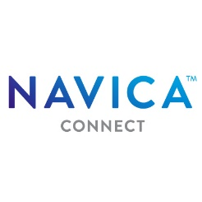
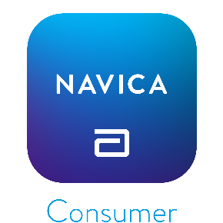
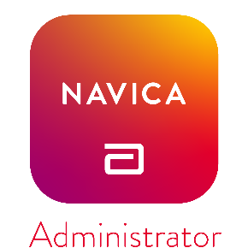
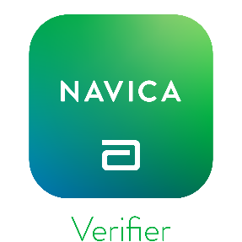
The NAVICA™ System Solution Overview
Simplicity
Based on familiar consumer experiences
Low learning required to setup and use without help
Designed to scale rapidly
Availability
Connect Portal available upon request
Apps available on App Store and Google Play Store
Security
Cloud based, scalable infrastructure with independent ongoing security assessments to maintain the security of the platform
Data is fully encrypted at all times
State reporting available through APHL AIMS Platform
Proprietary and confidential — do not distribute
Notes:
NAVICA was founded on three primary development principles, simplicity, availability, and security.
For simplicity, we understood that if we were to launch this type of application, it had to be based on familiar consumer experiences; something that was very similar in operation to the apps that we would have on our mobile devices today. That means there would be low learning required to set up the application, download it onto your phone, and to begin using it right away. We also knew that in order to access as many people as possible, we had to have something that was designed to scale up rapidly.
So from a scale perspective and an availability perspective, the consumer and Administrator apps are available today on the App Store and the Google Play Store for download onto your device. Of course, when dealing with this type of information, we have to ensure that we're constantly monitoring security. We have a cloud-based scalable infrastructure that is continually monitored, and the data is fully encrypted at all times.
Today, I'm going to focus on providing you with a brief overview of two of the primary applications that you will use with the NAVICA system. The NAVICA Consumer Application, which is for the test participant shown in blue here, and the NAVICA Administrator Application shown in red, this is the application that will be used by a top test operator. Someone that would be actually performing the BinaxNOW COVID-19 test.

Slide 32
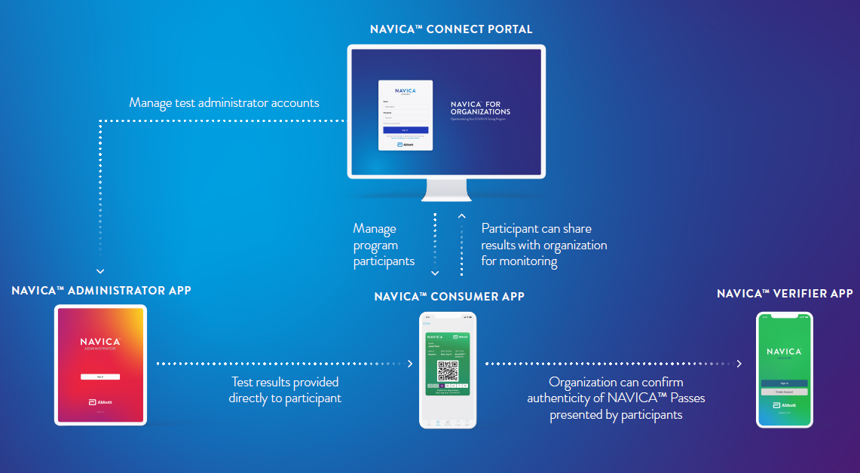
The NAVICA System Workflow Overview
Notes:
The testing program coordinator at your University Student Health Center would first set up NAVICA Connect. He’d load the employee roster so he could see all current students listed, and then send an invite to all of your students from Connect.
Students would get an email telling them that their University is starting an on-site testing program and they need to enroll. They’d be asked to download the Consumer app, create a profile, and link their profile to the University using a “Connect Code” provided in the email. Once they do this, on their phone as a student, the testing program coordinator can see in connect that (NAME) has now been connected.
Then the University would inform students of when their appointments are for testing. Students would go to the designated location at scheduled appointment times, and show the coordinator their NAVICA ID on the consumer app. It’s a QR code that says (NAME). The test administrator will probably be using an iPad or Android tablet with the NAVICA Administrator app. She’d scan the student’s NAVICA ID and scan the BinaxNOW test card to link the result to an authentic test. Then she’d collect the sample. When the test completes in 15 minutes, the coordinator would rescan the test card, which would pull up the student’s name, and she’d submit the result (positive, negative, invalid). The student would get a ping on their phone letting them know that a new result is available. If negative, it would give a green NAVICA Pass, like the one you see here.
So this is how the NAVICA system works. It brings tremendous additional value to our customers and our patients directly.

Slide 33
Training Toolkit
NAVICA™ APP AND BINAXNOW™ COVID-19 AG CARD
Notes:
Now, let’s take a look at the Training Toolkit and where to find important resources.

Slide 34
Training Toolkit
https://www.globalpointofcare.abbott/en/support/product-installation-training/navica-brand/navica-binaxnow-ag-training.html
Six Detailed Training Videos
PowerPoint Training
Helpful Tools & Support Documents
FAQs and Technical Service Contacts Monday-Friday 8am EST – 8pm EST 1-800-257-9525 or ts.scr@abbott.com
Proprietary and confidential — do not distribute
Notes:
The Training Toolkit has four core components: Videos designed to review key aspects of the BinaxNOW COVID-19 Ag Card, including quality control, patient or participant specimen collection and handling, and the NAVICA App Support Tools that include a Product Insert, Procedure Card, sampling technique helpful tips, critical process documents and helpful tips surrounding CLIA requirements. There is also a helpful training presentation slide deck that can be downloaded and used to train each testing team. FAQs or Frequently Asked Questions and Support Contacts, connecting you to the Abbott Technical Services Team.
(NAVIGATE TO LIVE WEBSITE)
So let’s take a closer look at the actual website where you can find the Training Toolkit and the Resources just mentioned.
The BinaxNOW COVID-19 Ag Card Overview is a two-minute video that gives a complete summary of what is included in the kit as well as the testing process from start to finish, including result interpretation.
NAVICA Consumer Demonstration Video is a link to a 1:19 long YouTube video that provides a high-level look at this app and how it works with the BinaxNOW Test Card.
These video modules provide snapshots of key aspects of the BinaxNOW test. All videos can be downloaded so you don’t have to come back to the site to view, and the website provides an excellent resource to share information with others in your organization.
Module 1/Getting Started is 1:50 long. It provides an overview of the test, reviews test kit contents and kit storage and stability.
Module 2 is a bit over 4 minutes, and it provides information on quality controls of the BinaxNOW test, including frequency requirements for testing and the testing procedure.
Module 3/Specimen Collection & Handling is 1:32 long and reviews requirements for collecting and handling nasal swab specimens.
Module 4 is 2:56 long and reviews the patient test procedure.
Module 5 is 4 and a half minutes long and provides an overview of the NAVICA App and how to use this important application along with the BinaxNOW test card.
Module 6 provides and overview of the NAVICA Admin App.
In Helpful Documents, you will find:
A Training presentation, containing many of the slides that were presented here today. It is a PDF that can be downloaded to provide on the spot training.
The Product Insert and Procedure Card are included in each BinaxNOW COVID-19 Ag Test Card kit. But in case those are missplaced or new copies are needed, they are here to easily download.
Nasal Swab Tech Tips is a simple one-page guide on collecting a patient sample.
The CLSI document (CLSI stands for Clinical and Laboratory Standards Institute), is a very detailed description of the Laboratory Procedures to follow to perform the BinaxNOW test, as well as result interpretation, limitations and performance characteristics to name just a few of the topics covered under this comprehensive document.
Lastly, the CLIA-waived testing document provides key information about this important requirement and, if needed, direction on to how to apply for a CLIA license.
The Frequently Asked Questions segment will be updated as additional questions arise.
What kind of test and accuracy, addressed in the product presentation, provides a brief description of the BinaxNOW test and talks to the clinical study data submitted to the FDA.
The PPE question gives general guidance regarding PPE and disposal of kit components. More specific guidance is available from the CDC website or your state’s Department of Public Health.
A CLIA license is required to run the BinaxNOW COVID-19 Test. If you do not currently have such a license or would like additional information, there is a quick link embedded within this question. Simply hover over the “Download the informational sheet” and click on the link. This two-page document provides quite a bit of information and resources to help guide you, and as I mentioned, is also included in the Helpful Documents section.
Guidance for Quality Control or QC testing is detailed in this section.
The NAVICA APP information is being updated frequently.
Support Contacts point you to the Abbott Technical Services Team. The hours for coverage are Monday through Friday, 8am Eastern Standard Time to 8pm Eastern Standard Time. The Abbott Technical Services Team can also be emailed: ts.scr@abbott.com.
When you call the 800#, select Option 2 for the Technical Services team; Option 1 reaches Customer Service.
The References section provides clarity around the Emergency Use Authorization, which we covered earlier.

Slide 35
Additional Resources
Ordering Information
195-000: BinaxNOW™ COVID-19 Ag Card (40 Tests)
195-080: BinaxNOW™ COVID-19 Ag Control Swab Kit (10 Positive Swabs)
190-010: Optional COVID-19 Swab Transport Tube Accessory Pack (24 Tubes)
Technical Support Line:
US +1 800 257 9525, Option 2
– 8am-8pm EST Monday-Friday
t s.scr@abbott.com

Slide 36
BinaxNOW™ COVID-19 Ag Card
NAVICA™ App
Questions?

Slide 37
The BinaxNOW™ COVID-19 Ag Test Card has not been FDA cleared or approved. It has been authorized by the FDA under an emergency use authorization for use by authorized laboratories. The test has been authorized only for the detection of proteins from SARS-CoV-2, not for any other viruses or pathogens, and is only authorized for the duration of the declaration that circumstances exist justifying the authorization of emergency use of in vitro diagnostic tests for detection and/or diagnosis of COVID-19 under Section 564(b)(1) of the Federal Food, Drug and Cosmetic Act, 21 U.S.C. § 360bbb-3(b)(1), unless the declaration is terminated, or authorization is revoked sooner. It is authorized for prescription home use with self-collected observed direct anterior nasal (nares) swab samples from individuals aged 15 years or older who are suspected of COVID-19 by their healthcare provider within the first seven days of symptom onset.
© 2021 Abbott. All rights reserved. All trademarks referenced are trademarks of either the Abbott group of companies or their respective owners. Any photos displayed are for illustrative purposes only. 120006994-12 03/21

